Slide 1

Operating Systems Basics

Slide 2
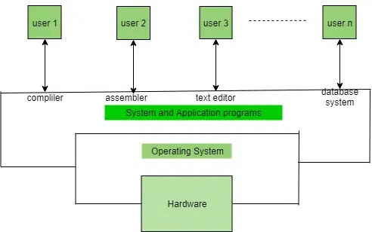
Operating systems are a software that is used to manage and handle the computer’s hardware and software resources.
It’s responsible for managing and controlling of all activities and sharing of computer resources to all running applications.
A low-level software that includes all basic funtions like process management, memory management, file management etc…
It’s a government for our system, and it has different departments to manage different resources.
Example’s are like Linux, Unix, Windows 11, Andriod, Ios, MacOs, etc…

Slide 3
Introduction of Operating Systems
It’s an interface b/w computer hardware and user.
It’s a software that provide an environment to the user for executing programs in conveniently and efficiently.
It’s a software that manages computer hardware and software, the hardware must provide appropriate mechanisms to ensure the correct operation of the computer system and to prevent user programs from interfering with the proper operation of the system.
It’s a program that runs all the time in our computer, with else being application programs.
Concerned with the assignments of resources among programs e.g, memory, processors and input/output devices.

Slide 4
Types of Operating Systems

